Slide 1


DATA SCIENCE EL-334 BSIT
LECTURE # 05
Data manipulation and Cleaning
Python Pandas: A Data Science Library
by
Safoora Qurban

Slide 2

Python Pandas: A Data Science Library

Slide 3
The pandas DataFrame object
The pandas DataFrame object extends the capabilities of the Series object into two-dimensions.
A Series object adds an index to a NumPy array but can only associate a single data item per index label, a DataFrame integrates multiple Series objects by aligning them along common index labels.
This automatic alignment by index label provides a seamless view across all the Series at each index label that has the appearance of a row in a table.
A DataFrame object can be thought of as a dictionary-like container of one or more Series objects, or as a spreadsheet

Slide 4
The pandas DataFrame object(cont.)
A DataFrame also introduces the concept of multiple axes, specifically the horizontal and vertical axis i.e rows and columns.
Functions from pandas can then be applied to either axis, the operation be applied horizontally to all the values in the rows, or up and down each column.

Slide 5
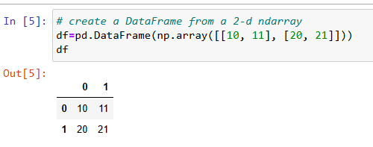
Creating DataFrame
There are several ways to create a DataFrame. Probably the most straightforward way, is by creating it from a NumPy array.
The following code creates a DataFrame from a two dimensional NumPy array.
Each row of the array forms a row in the DataFrame object. Since we did not specify an index, pandas creates a default int64 index in the same manner as a Series object. Since we did not specify column names, pandas also assigns the names for each column with a zero-based integer series.

Slide 6
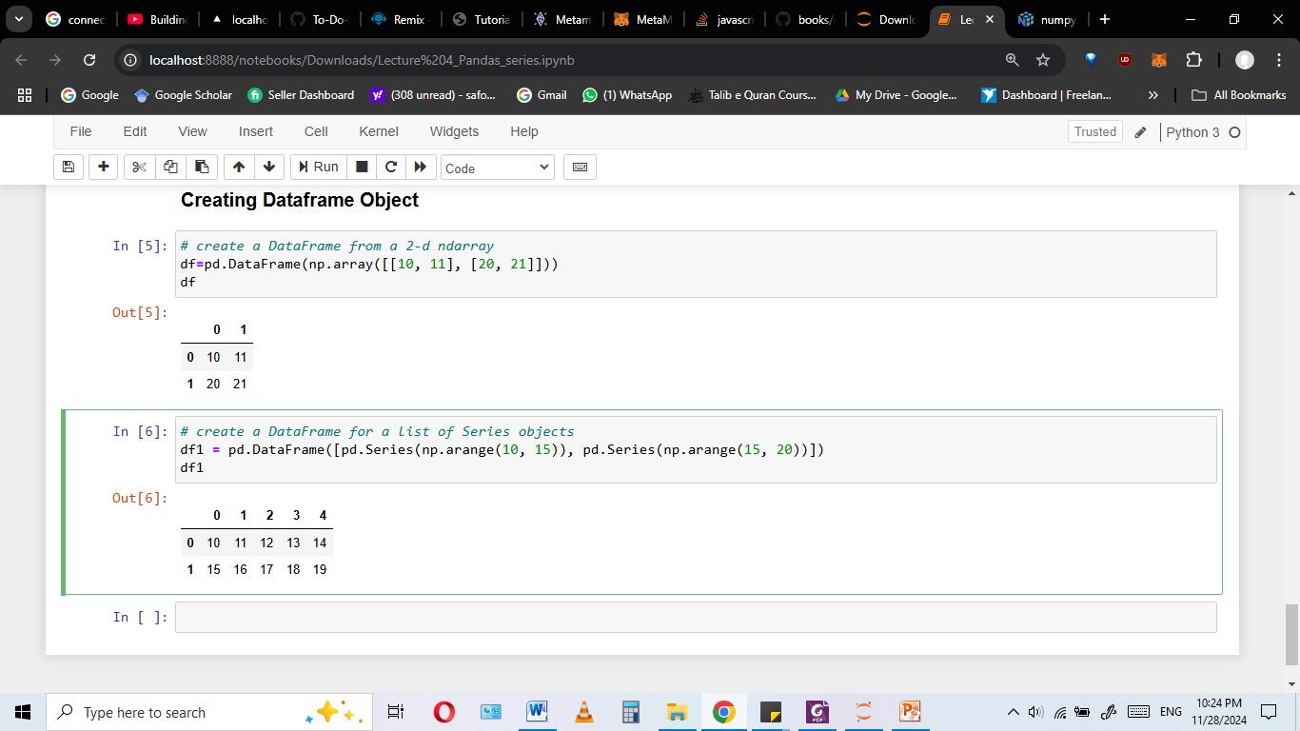
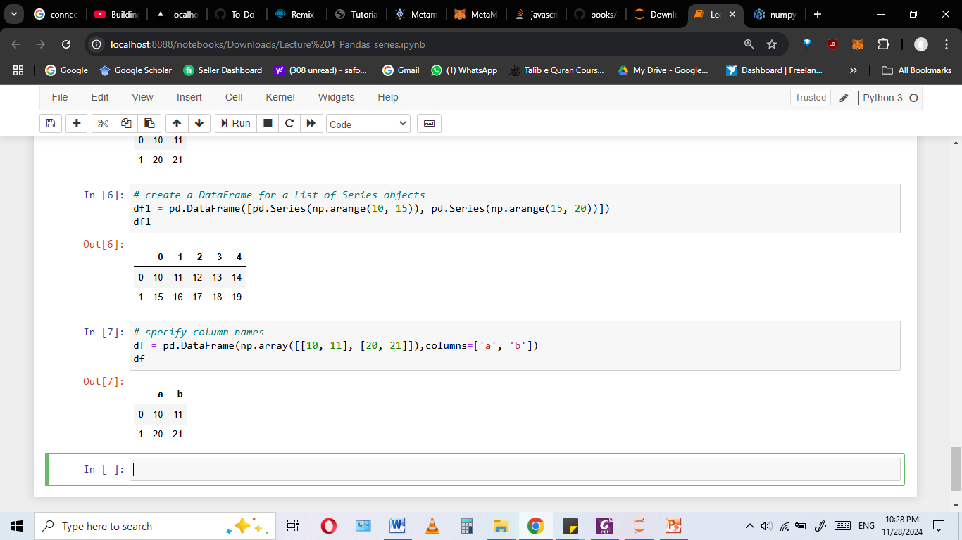
Creating DataFrame (cont.)
A DataFrame can also be initialized by passing a list of Series objects.
Column names can be specified at the time of creating the DataFrame by using the columns parameter of the DataFrame constructor. And The names of the columns of a DataFrame can be accessed with its .columns property

Slide 7
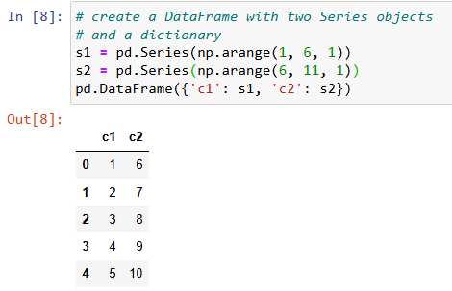
Creating DataFrame (cont.)
A DataFrame object can also be created by passing a dictionary containing one or more Series objects, where the dictionary keys contain the column names and each series is one column of data:

Slide 8
Changing DataFrame columns and index
The names of the columns can be changed by assigning a list of the new names to the .columns property just like changing index in series.
Index labels can likewise be assigned using the index parameter of the constructor or by assigning a list directly to the .index property
The dimensions of a DataFrame object can be determined using its .shape property. A DataFrame is always two-dimensional. The first value informs us about the number of rows and the second value is the number of columns

Slide 9
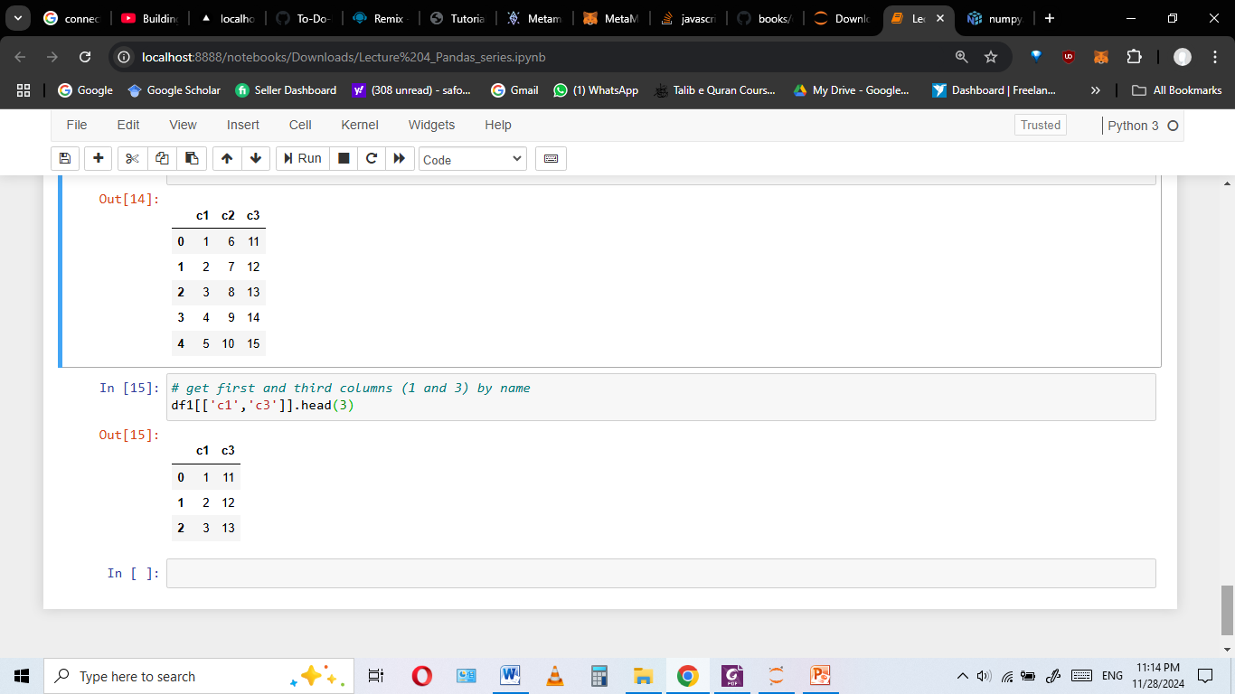
Selecting columns of a DataFrame
Selecting the data in specific columns of a DataFrame is performed by using the [] operator.
Passing a single integer, or a list of integers, to [] will have the DataFrame object attempt to perform a location based lookup of the columns.
The following code retrieves the data in the first and third columns:

Slide 10
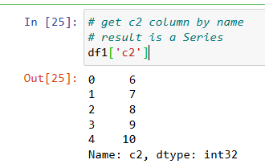
Selecting columns of a DataFrame (cont.)
If the values passed to [] consist of nonintegers, then the DataFrame will attempt to match the values to the values in the columns index. The following code retrieves the c2 column by name
Multiple columns can be selected by name by passing a list of the values, and results in a DataFrame (even if a single item is passed in the list)

Slide 11
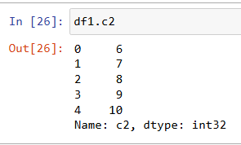
Selecting columns of a DataFrame (cont.)
Columns can also be retrieved using what is referred to as attribute access. Each column in a DataFrame dynamically adds a property to the DataFrame for each column where the name of the property is the name of the column. Since this selects a single column, the resulting value is a Series:

Slide 12
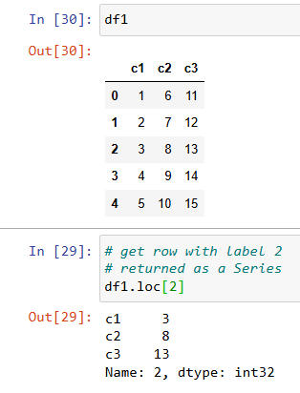
Selecting rows by index label and location: .loc[] and .iloc[]
Rows can be retrieved via an index label value using .loc[]. This is shown in the
following code:

Slide 13
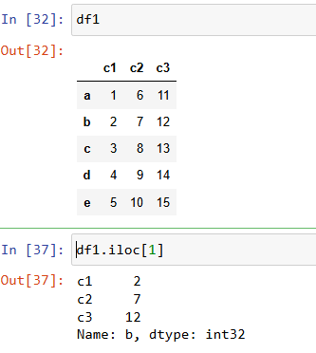
Selecting rows by index label and location: .loc[] and .iloc[]
Rows can also be retrieved by location using .iloc[]. It takes integer index and return whole row corresponding to that index in dataframe.

Slide 14
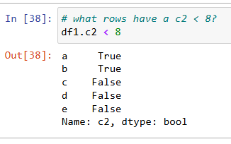
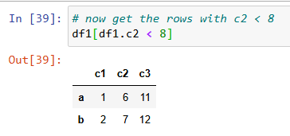
Selecting rows of a DataFrame by
Boolean selection
Rows can also be selected by using Boolean selection, using an array calculated from the result of applying a logical condition on the values in any of the columns.
This allows us to build more complicated selections than those based simply upon index labels or positions.
This results in a Series that can be used to select the rows where the value is True.

Slide 15
Data Manipulation and Cleaning

Slide 16
What is Data Manipulation?
Data Manipulation refers to the process of adjusting, transforming, or organizing data to make it more suitable for analysis or further processing.
It involves cleaning, filtering, aggregating, and reshaping data to extract meaningful insights.
Pandas is a powerful library for data manipulation.

Slide 17
Data manipulation using Pandas
Here are the common steps involved in data manipulation using Pandas:
1
Loading Data
2
Inspecting Data
3
Data Cleaning
4
5
6
7
8
9
Data Transformation
Aggregation and Grouping
Merging Data
Reshaping Data
Exporting Data
Data Filtering and Selection

Slide 18
1. Loading Data
First, data is loaded into a Pandas DataFrame. It involves the process of reading data from external source on which you want to work, often from CSV, Excel, or other file formats :
To read CSV data into a DataFrame, the pandas pd.read_csv() function is used
To read EXCEL data into a DataFrame, the pandas pd.excel_csv() function is used
You can specify which column(s) should be the index in the call to read_csv() using the index_col parameter by assigning it the zero-based position of the column to be used as the index.

Slide 19
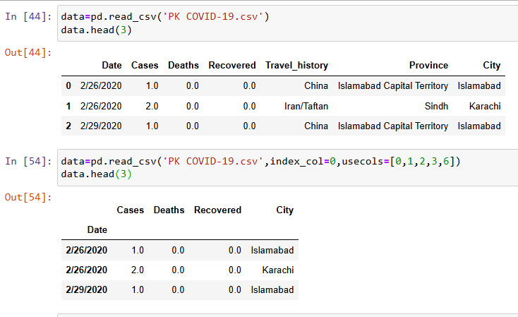
1. Loading Data (Cont.)

Slide 20
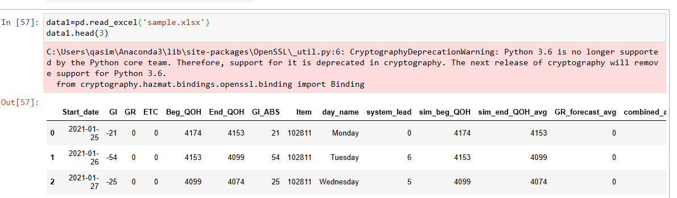
1. Loading Data (Cont.)

Slide 21
2. Inspecting Data
After loading data, it's important to inspect the data structure it includes:
Printing first few rows of data:
df.head() function of pandas is used to print first few records of data.
Printing last few records of data:
df.tail () function of pandas is used to
Checking number of rows and columns in data:
df.shape is used to get shape of data which tells the number of rows and columns in data
Checking data types of each column in data:
df.dtypes function of pandas is used to check data types of each column in data.
Calulating statistical description of data:
df.describe() function of pandas provides statistical description of data.
Checking columns and index : df.columns and df.index used to get columns and index of dataframe

Slide 22
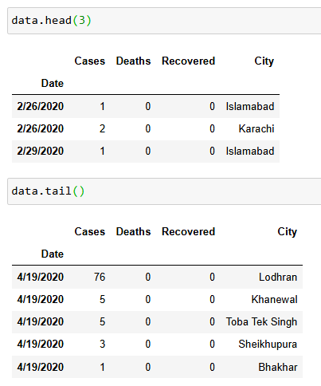
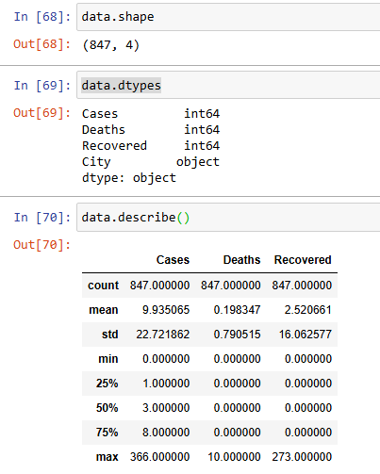
2. Inspecting Data (Cont.)

Slide 23
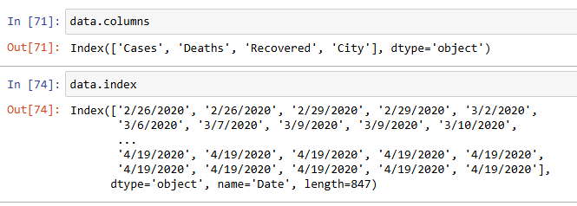
2. Inspecting Data (Cont.)

Slide 24
3. Data Cleaning
Data cleansing is an essential part of the data analytics process. Data cleaning using Pandas removes incorrect, corrupted, garbage, incorrectly formatted, duplicate, or incomplete data within a dataset.
Data often requires cleaning by:
Checking Missing values: df.isnull().sum() function returns number of missing values in each column in data
Handling missing values:
Missing rows can be dropped by df.dropna() function of pandas
Missing values can be filled using df.fillna(value) function
Missing values can also be filled with special methods i.e. mean, median, mode
df.fillna(df.mean())

Slide 25
3. Data Cleaning (cont.)
Removing duplicates:
df.drop_duplicates() function of pandas used to drop duplicate values
Renaming columns/indexe labels:
DataFrame.rename() is used for renaming columns or indexe labels of a dataframe

Slide 26
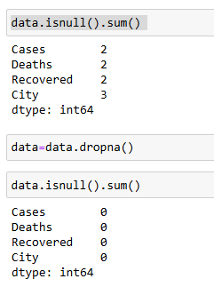
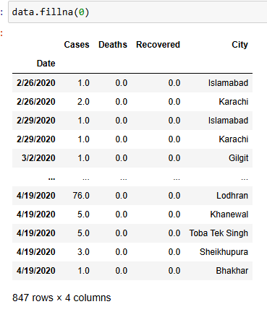
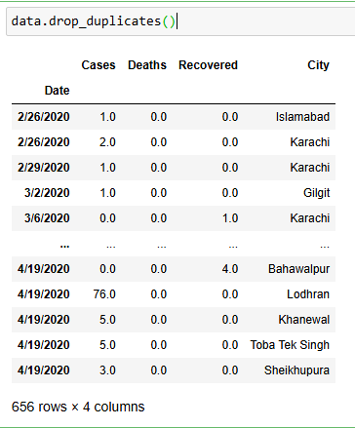
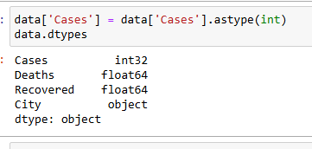
3. Data Cleaning (cont.)

Slide 27
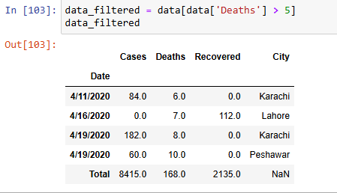
4. Data Filtering and Selection
Filter rows based on conditions: data_filtered = data[data[Deaths'] > 5]
This will select records with deaths more than 5
Selecting specific columns:
selected_columns = data[[‘Cases', ‘City']]
This will select only columns “Cases”, and “City”

Slide 28
5. Data Transformation
Data Transformation is the process of converting raw data into a format or structure that would be more suitable for discovering insights or pass it to an algorithm or a model.
It involves transforming existing data into another presentation. This may be needed for the following reasons:
Values are not in the correct units
Values are qualitative and need to be converted to appropriate numeric values

Slide 29
5. Data Transformation (cont.)
Data Transformation may consists on following:
Converting data types:
Data type of a specific column can be changed using .astype(int) function on that column like
df['column'] = df['column'].astype(int)
Apply functions to columns:
df['new_column'] = df['existing_column'].apply(lambda x: x * 2)
Creating new columns:
df['new_column'] = df['column1'] + df['column2']

Slide 30
6. Grouping and Aggregation
Grouping data by specific columns and applying aggregate functions:
df_grouped = df.groupby('category').agg({'value': 'sum'})
A groupby operation involves some combination of splitting the object, applying a function, and combining the results. This can be used to group large amounts of data and compute operations on these groups.
The aggregation operations are always performed over an axis, either the index (default) or the column axis. For example apply mean median mode functions on each group.

Slide 31
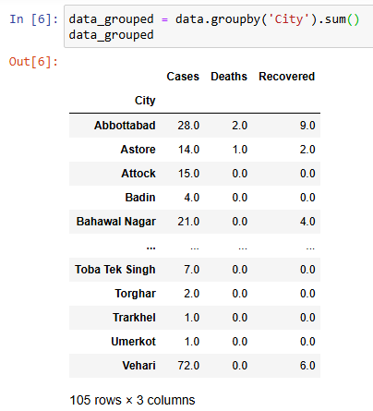
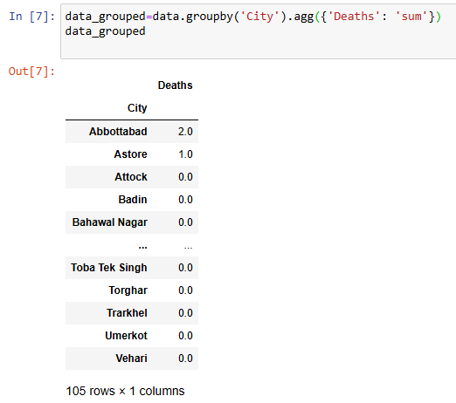
6. Aggregation and Grouping (cont.)

Slide 32
7. Merging and joining
The pandas library has a method called merge() for combining DataFrames or named Series into a singular DataFrame for better data analysis.
The pandas merge operation combines two or more DataFrame objects based on columns or indexes in a similar fashion as join operations performed on databases. The goal is to have a new dataset while the sources remain unchanged.
A pandas merge can be performed using the merge() function.
merged_df = df1.merge(df2, on='key_column‘, how='inner')

Slide 33
7. Merging and joining (cont.)
How parameter: This defines the type of merge to be performed. The default is inner; others include outer, cross, left, and right.
left: use only keys from left frame; preserve key order.
right: use only keys from right frame; preserve key order.
outer: use union of keys from both frames
inner: use intersection of keys from both frames, preserve the order of the left keys.
cross: creates the cartesian product from both frames, preserves the order of the left keys.

Slide 34
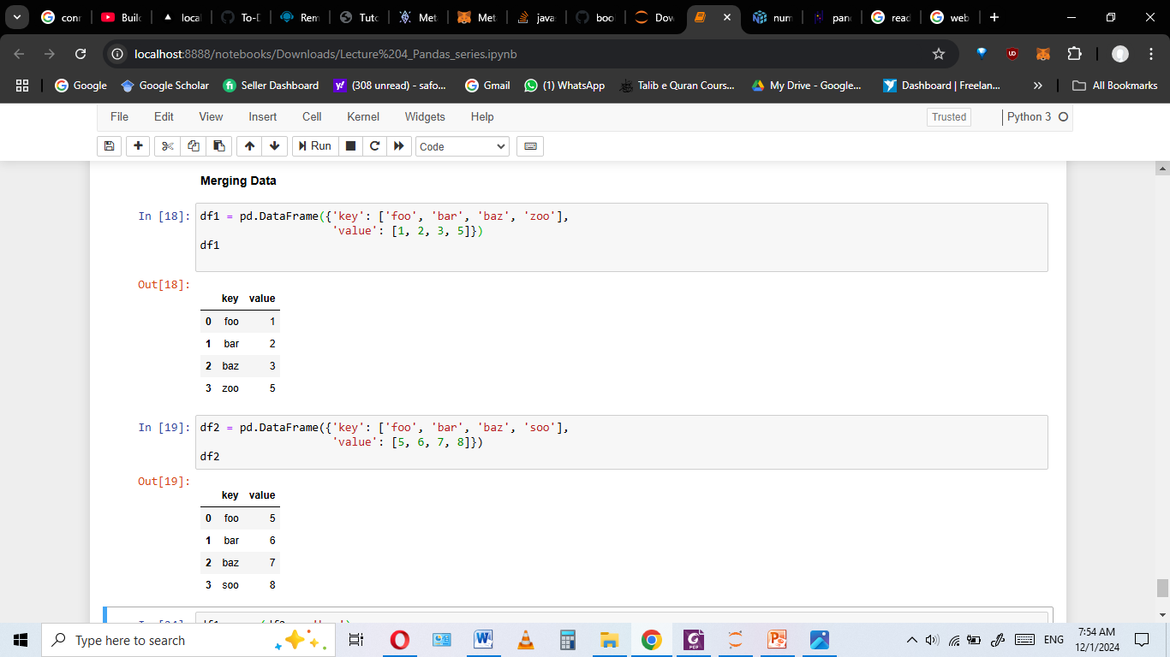
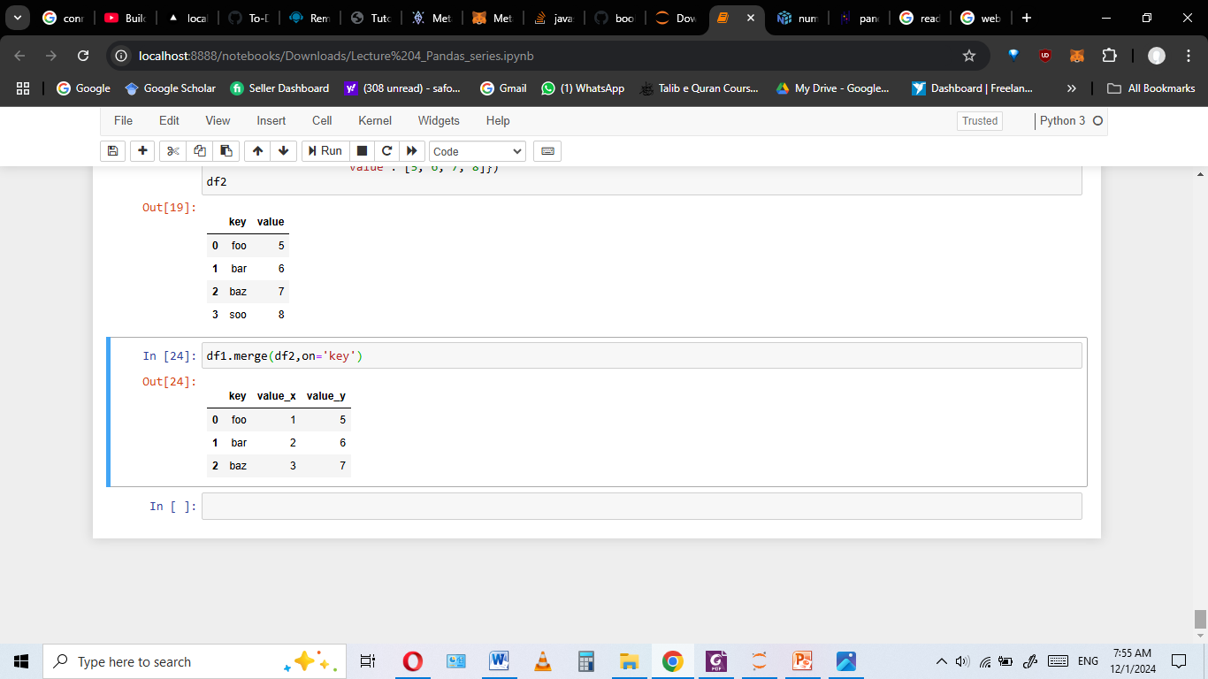
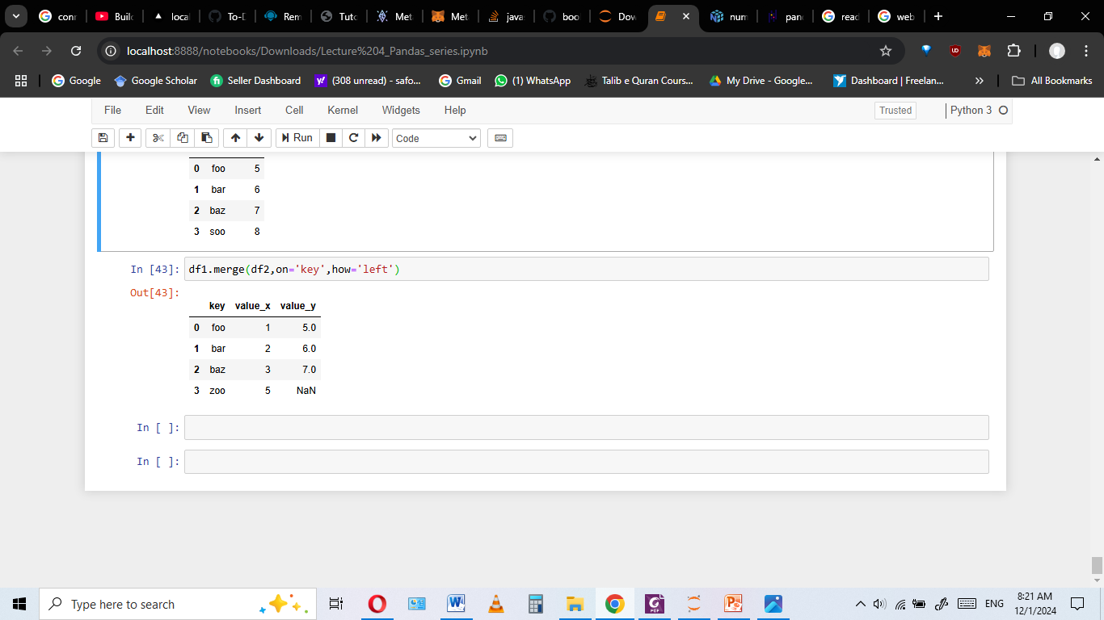
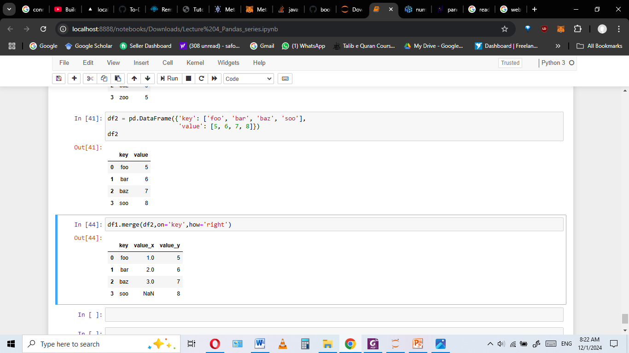
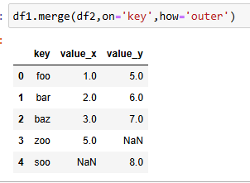
De
7. Merging and joining (cont.)
Default how parameter is ‘inner’

Slide 35
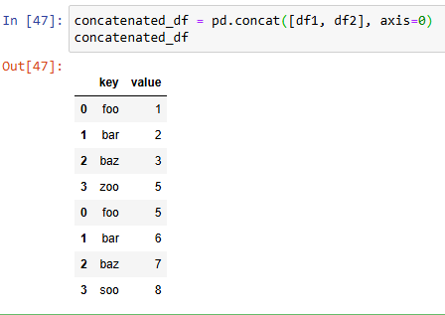
7. Merging and joining (cont.)
• Concatenate/Joining DataFrames:
Stacking two or more dataframes vertically or horizontally
concatenated_df = pd.concat([df1, df2], axis=0)

Slide 36
8. Reshaping Data
Reshaping data involves altering the representation of the data for further data processing or data summarization most common technique is creating pivot and pivot tables. These group unique values within one or more discrete categories.
Pivot: The pivot method reshape the data in the DataFrame to match the specified index, columns, and values
pivoted = df.pivot(index="date", columns="variable", values="value")
Pivot Table: A pivot table is a table that summarizes data by grouping it into categories and calculating various aggregate statistics.
table=pd.pivot_table (df, values=‘Sales’, index=‘Product’, columns=‘Month’, aggfunc=‘mean’)
pivot() can only handle unique rows specified by index and columns. If you data contains duplicates, use pivot_table().
For further understanding : https://medium.com/@filip.sekan/pivot-vs-pivot-table-methods-in-pandas-definitions-examples-differences-dcc9e14e667f

Slide 37
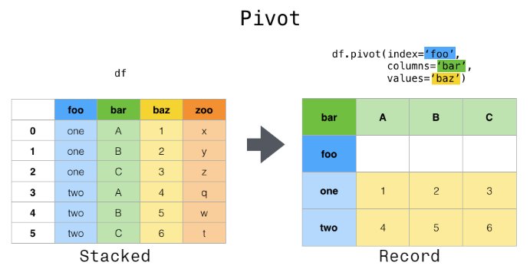
8. Reshaping Data

Slide 38
10. Exporting Data
After manipulation, data is often saved to a new file:
df.to_csv('processed_file.csv')
df.to_excel('processed_file.xlsx')
df: processed dataframe that you want to save/export
‘processed_file.csv’: file path where you want to save with file name
These are the steps provide a foundation for handling, cleaning, and transforming data efficiently in Pandas.

